Slide 1
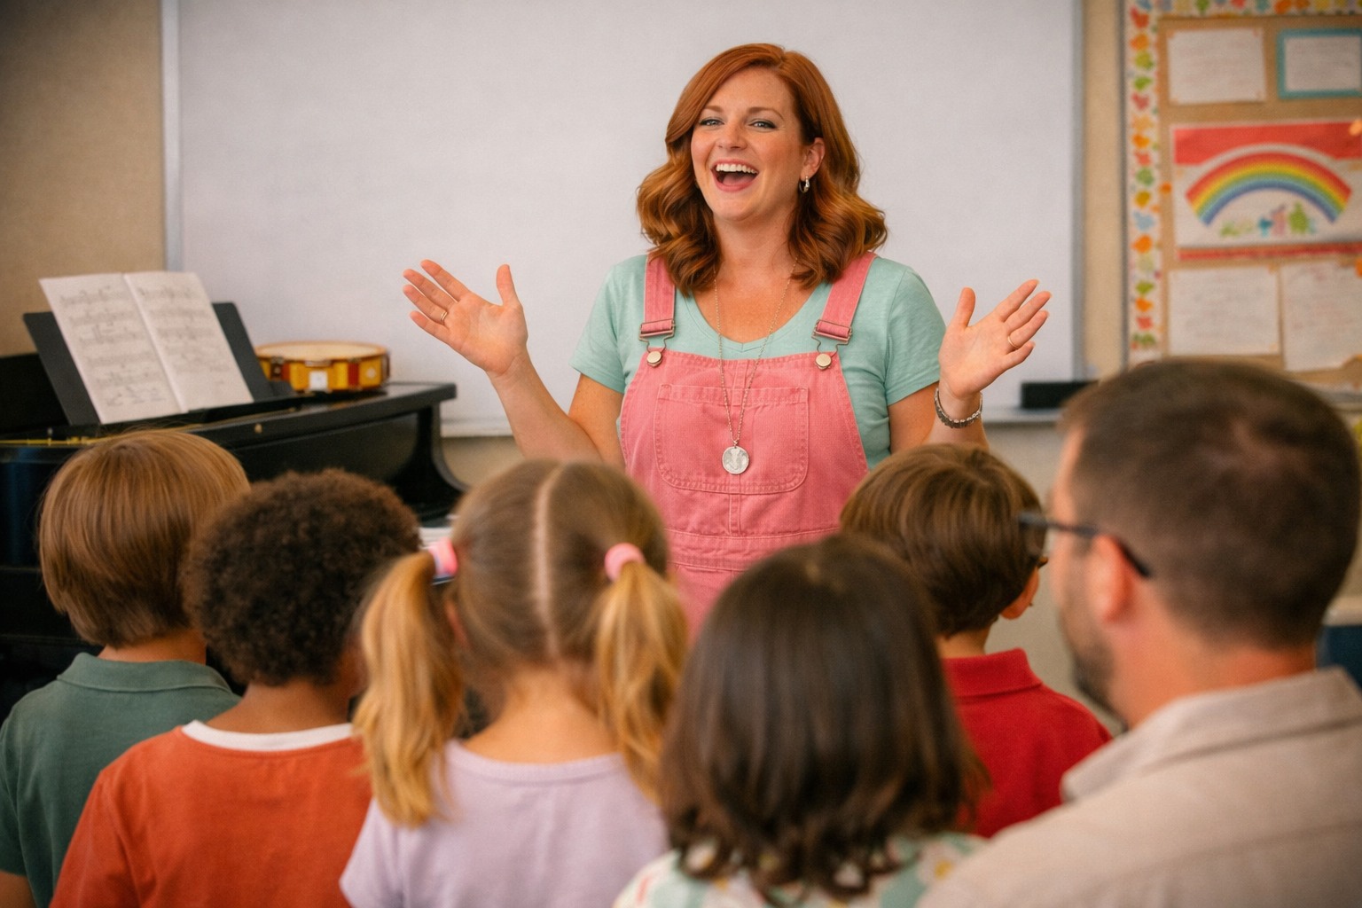





Building Confidence Teaching Singing
Fiona Bull
Music Lead
Storrington Primary School
Cultural Champion
fbull@storringtonprimary.co.uk

Slide 2
How to Teach a Song…
Explore the song – listening, moving, musical games, drawing.
Learn the song – words, rhythm, pitch, singing.
Perform the song– counting in, directing, actions, staging.
Share ideas

Slide 3
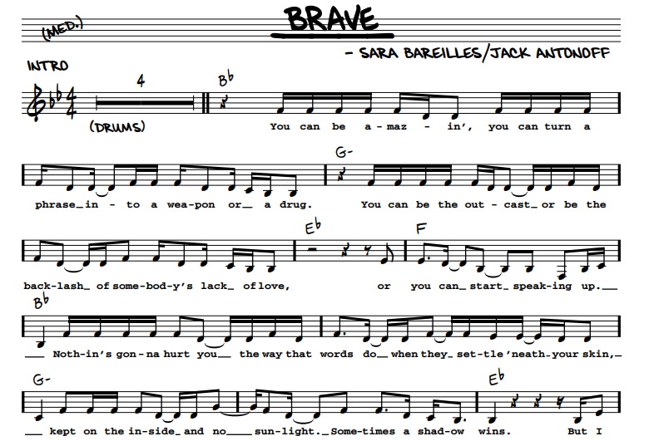
“I wanna see you be brave…”
Hardly anyone is tone deaf!
Children will love to sing with you.
Enthusiasm is key, you don’t have to be a pianist or be confident reading music.
Make sure you learn the song well before you start teaching it.
Have the words/music in your line of sight – on a music stand if possible.

Slide 4
Explore the song
You may want to change these depending on how many are in the room!
Move to the music – feel the pulse by tapping the body. I would do this sitting down if you are in the hall for a large singing assembly.
Copy the leader – different actions on the beat.
Classroom - Beatmaster – detective game – one person is the detective and leaves the room whilst you select a ‘beatmaster’. The ‘beatmaster’ changes the action and everyone copies. The detective has to try and guess who the ‘beatmaster’ is.
Classroom - Draw to the music – think about how the music makes you feel, listen to the lyrics. No wrong answers for this.
Children will already have started to learn the song by osmosis at this point!

Slide 5
Before you start singing
If you’re using one, let the audio track do the heavy lifting for you! Sing Up- you can change the tempo, instruments, voices etc.
If you playing the piano/guitar/uke – learn the chords or piano accompaniment – don’t give yourself the challenge of sight reading it whilst you’re also trying to teach the singing.
Warm up – make sure children’s voices are warmed up before you begin.

Slide 6
Before you start singing
Counting in - numbers or ‘ready, steady, off we go’ at starting pitch (if you’re confident to, if not then just speak it at tempo).
Starting note – give the children a starting note either with your voice or on a piano/glock/audio track.
Listen to the introduction on the backing track.
Tempo – if you’re not using a backing track, make sure you don’t come in too fast or too slow. There are lots of metronome apps that can ‘tick’ a tempo for you. If you’re not sure of the tempo, put the track on and do your best ‘Dad dancing’ to feel the groove!

Slide 7
Learn the song
Choose part of the song to learn first - usually the chorus as they will then have learnt over half the song already which helps to build their confidence.
My turn, your turn as you teach it – don’t sing with the children. You can speak rather than sing and then use the track to all sing together.
Words – think about the meaning, this will help with performance.
Break down trickier phrases into smaller parts then build up to the whole line –
‘say what you’
‘say what you wanna say’
‘say what you wanna say, and let the words fall out’

Slide 8
Learn the song
Rhythm – say and clap.
‘say what you wan-na say’
Pitch – sing to ‘lee’ first before adding in the lyrics.
‘ lee lee lee lee-lee lee’
Go slower to start with.
Now add the words!
Actions – add actions to help them remember the words and increase engagement.
Hand signals to help the children – leader moving hand up and down to follow pitch (you don’t have to be able to read music to do this) and show length of notes.

Slide 9
Learn the song
You can be amazing
You can turn a phrase into a weapon or a drug
You can be the outcast
Or be the backlash of somebody's lack of love
Or you can start speaking up
Nothing's gonna hurt you the way that words do
When they settle 'neath your skin
Kept on the inside and no sunlight
Sometimes a shadow wins
But I wonder what would happen if you
Say what you wanna say
And let the words fall out
Honestly I wanna see you be brave
With what you want to say
And let the words fall out
Honestly I wanna see you be brave

Slide 10
Perform the song
Hand directions to support children
Posture – even if they are sitting down.
Staging
Audience
Share ideas and successes!

Slide 11
Links to videos
Youtube video:
https://www.youtube.com/watch?v=QUQsqBqxoR4&list=RDQUQsqBqxoR4&start_radio=1
Karakoke video:
https://www.youtube.com/watch?v=n86DI8GbzB4&list=RDn86DI8GbzB4&start_radio=1

